Slide 1
SMART Fitness Assessment
Lei Dunn, CHES
HPAI 2022

Slide 2
Hello!
I am Lei Dunn
I am the K-12 Instructional Specialist for HPE for Virginia Beach City Public Schools, part of the ODU Darden College of Education Faculty, and a School Health Professional Learning Team member.
You can find me at:
@leidunn_vb

Slide 3
We have 3 objectives today…
DESCRIPTION AND FUNCTION
SMART Fitness Assessment
DIGITAL GOAL TRACKING
OFFLINE JOURNALS

Slide 4
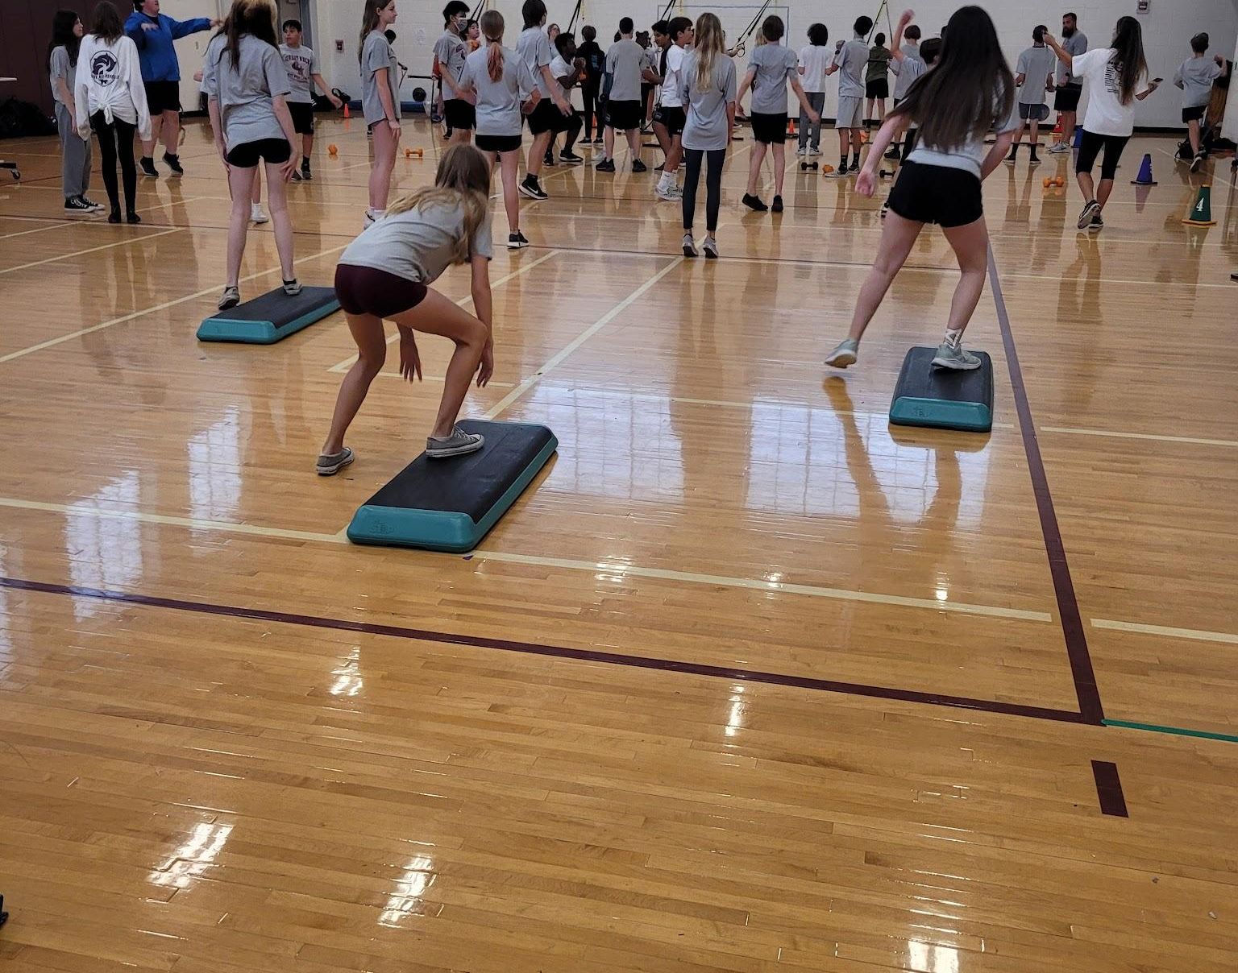
Consider your motives
What are your personal biases regarding fitness testing, positive or negative?

Slide 5
Description and Function
SMART Goals
should follow
VA Wellness Tests

Slide 6
BIG CONCEPT
SMART goals and fitness testing work together in reality and in grading.

Slide 7
Virginia Health AND PE SOL’s Relating to SMART Goals and FItness Testing
Fitness Testing
4.3.b, 5.3.a, 5.3.b, 6.3.e, 6.3.a, 7.3.b, 8.3.a, 11/12.3a
*Health SOL’s
SMART Goals
4.3.e, 5.3.b, 6.3.a, 7.3.b, 8.3.a, 9.3.f, 10.3.a, 11/12.3.e
6.3.f, 8.1.f, 8.3.g*
FITT Principle
4.3.f, 5.3.c, 6.3.f, 6.3.a, 7.3.c, 7.3.b, 8.3.c, 8.3.d, 9.3.a, 11/12.3.b, 11/12.3.c, 11/12.3.e
4.3.e, 8.3.h, 9.3.d; 10.3.b, 10.3.c*

Slide 8
These two cycles work in harmony throughout a health and PE course
Fitness Test
FITT Plan
Evaluate
Test
SMART Goal
Measure

Slide 9
Consider the ethics of measuring a child’s fitness test scores.

Slide 10
Offline Journals
Test
then
Assess

Slide 11
BIG CONCEPT
Printed journals give students regular reminders of where they started and where they are going.

Slide 12
Benefits of Offline Journals
Fast
Simple to navigate
Easy summative or formative assessment
You do lose the ability to apply accomodations with paper and pencil, plus if it gets lost, the student would need to start over.

Slide 13
Most appropriate when
3rd grade through 8th grade The teacher is keeping the journal between classes
Students are completing the workouts during HPE class time
Studnets have HPE class 3 or more times per week

Slide 14
Link to Paper Journal
https://docs.google.com/document/d/1-5dTyogIXKRdbNxUlBBmsf12-naJLq6u/copy

Slide 15
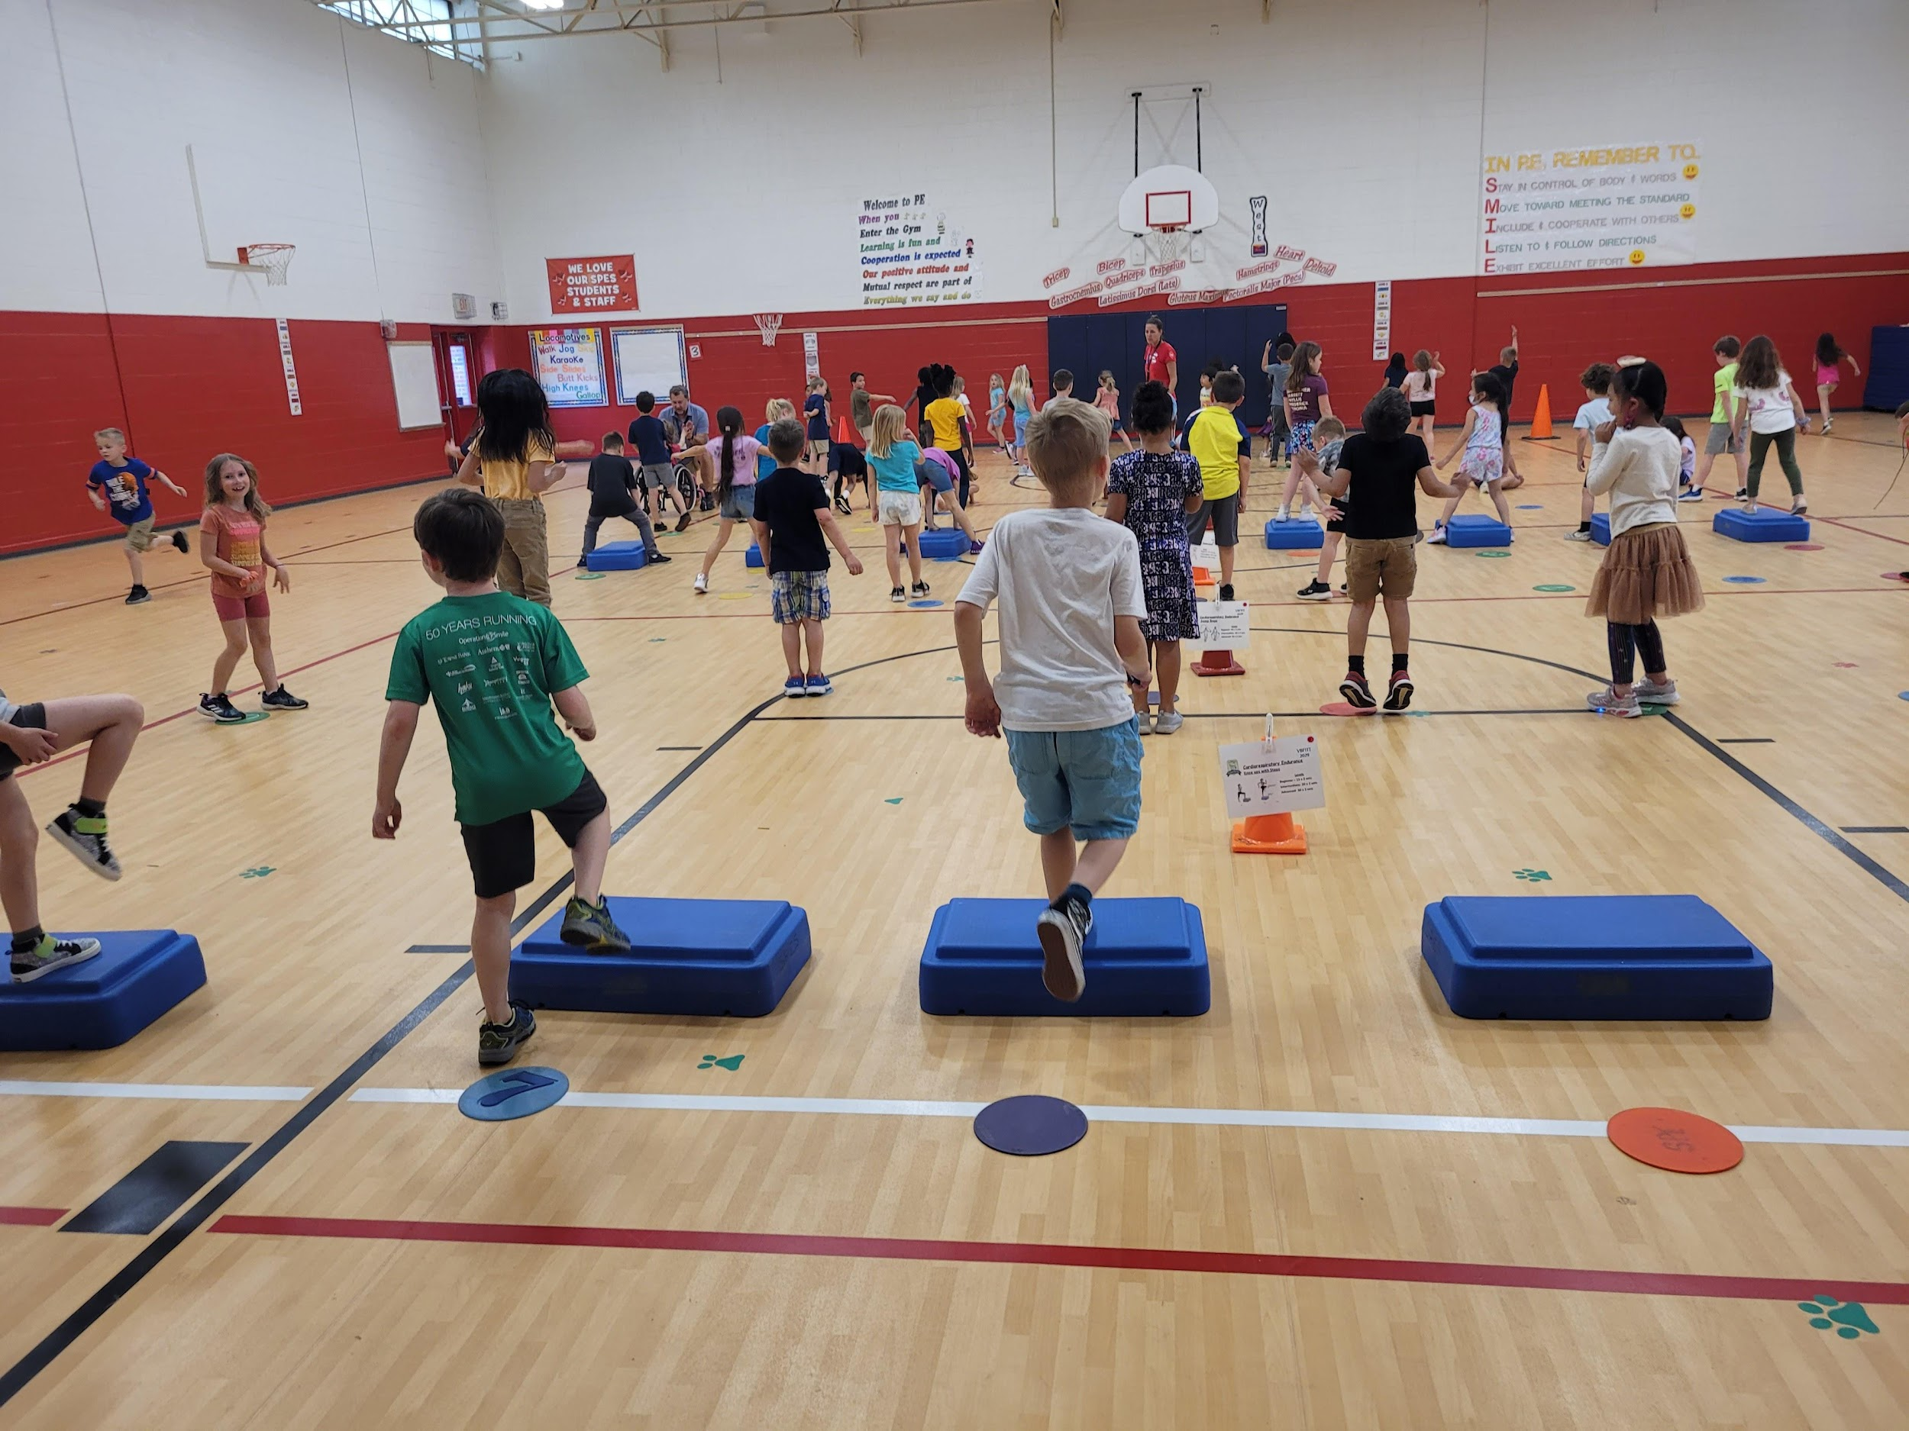
Plan to make
fitness a habit for your students.

Slide 16
Digital Goal Tracking
Portability
&
Accountability

Slide 17
BIG CONCEPT
Digital journals offer a real-world fitness experience.

Slide 18
Most appropriate when
6th grade through 12th grade The teacher is only checking journal periodically
Students are completing the workouts during HPE class or at home
Students have HPE class 1-3 times per week

Slide 19
Benefits of Digital Tracking
Accessible from a variety of settings
Adaptability
Most useful for summative assessment
You do lose the ability to tack your tracking to a variety of settings, outside for instance; this format also requires every student to have access to a device, sometimes out of school as well.

Slide 20
Place your screenshot here
Link to Online Journal
https://docs.google.com/forms/d/1OUSRgDAtdOIS4ATT60GY7_rOtebkOzrdVs1TsXcbp9c/copy

Slide 21
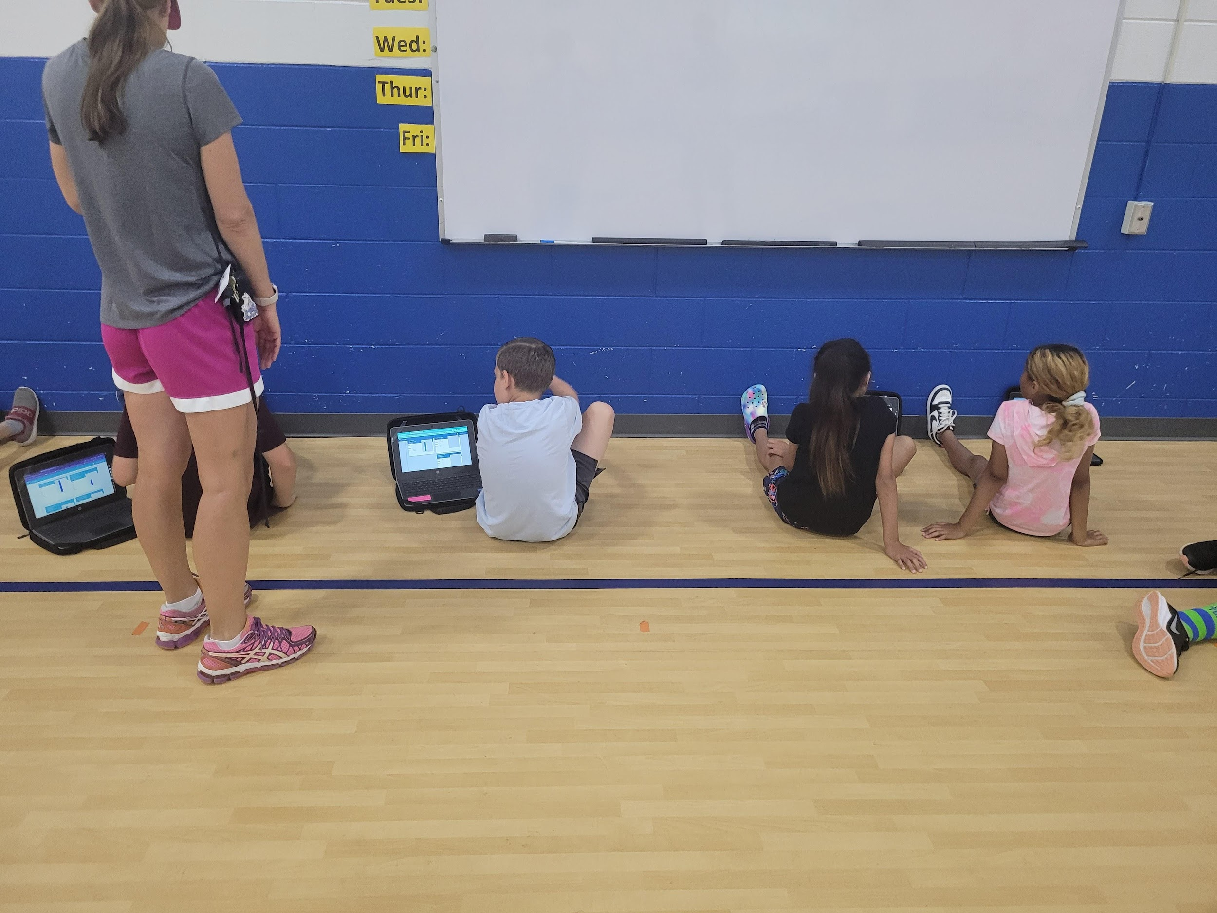
Remember to
give students agency of their scores and plans.

Slide 22

Other Digital Tracking Formats
If you have access to Welnet, you have access to digital tracking and assessment tools that will move with your student through each grade level.

Slide 23

Surey
Please scan the QR Code for a link to the short 4 question feedback survey and access to the presentation slides
Place your screenshot here

Slide 24
Thanks!
Any questions?
You can find me at @leidunn_vb & lcdunn@vbschools.com

