Slide 1
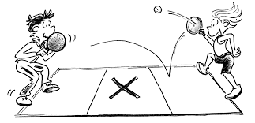
Instant Activity: Street Racket Partner Rally
Directions:
Get a partner and a set of equipment.
Rally making sure the ball bounces once before striking.
No volleys---no downward hits.

Slide 2
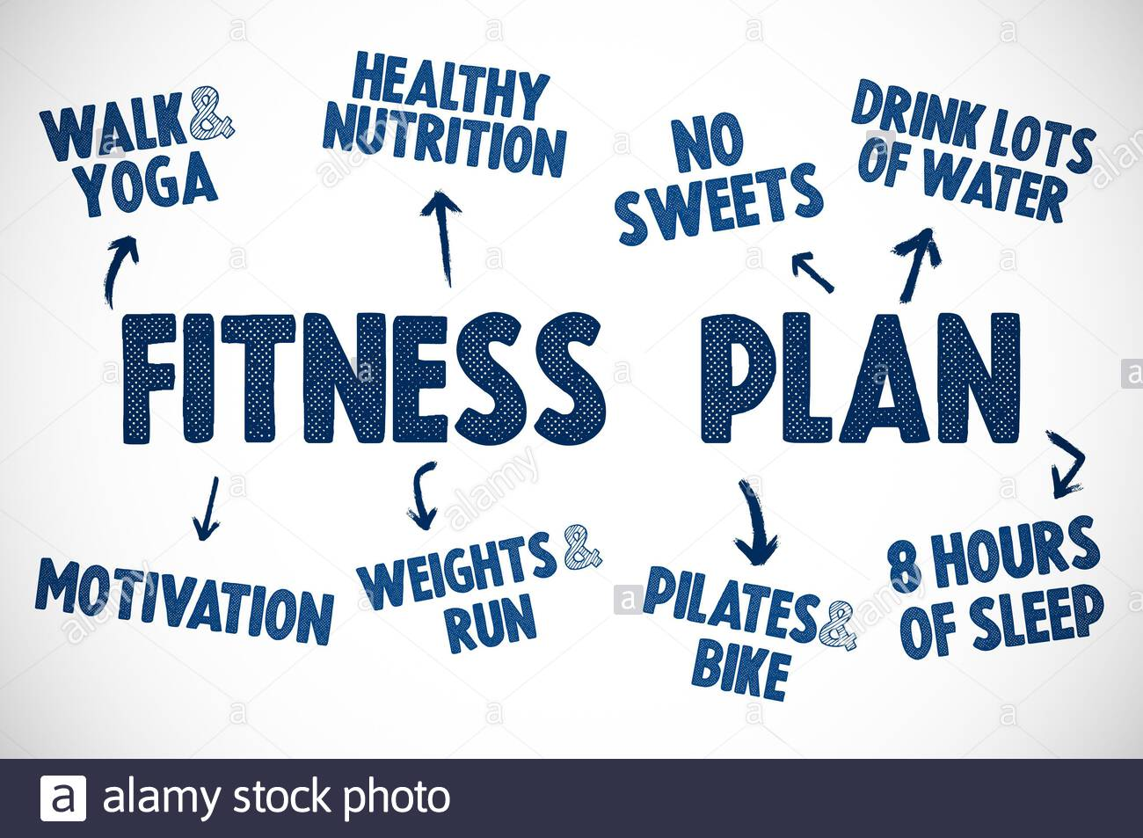
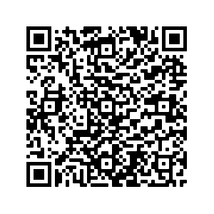
Student Designed Workouts
Ron Trainum, Toano Middle School
Williamsburg-James City County Public Schools
Ronald.Trainum@wjccschools.org
Twitter: @rtrainum1

Slide 3
What? Why?
Virginia Physical Education Standards of Learning: Fitness Planning Strand
6.3 The student will apply skills of measurement, analysis, goal setting, problem solving, and decision making to improve or maintain physical fitness.
Create a basic personal fitness plan for at least one health-related component of fitness, including baseline fitness data, a SMART goal, activities that will address the goal, a log of activities inside and outside school, reassessment data (post-data) and reflection of goal progress/attainment.
7.3 The student will apply concepts and principles of training and fitness-planning skills to improve physical fitness.
Identify safe practices for improving physical fitness.
Complete a self-assessment of health-related fitness and develop a comprehensive personal fitness plan, including SMART (specific, measurable, attainable, realistic, timely) goals, an action plan that incorporates the FITT (frequency, intensity, time, and type of exercise) principle and to meet the Centers for Disease Control and Prevention’s Physical Activity Guidelines for Americans, timeline, documentation of activities inside and outside school, roadblocks/barriers and solutions, midyear and end-of-year assessments, and reflection on progress for improving at least two self-selected components of health-related fitness.
Identify and apply concepts of fitness improvement using various resources, including available technology, to evaluate, monitor, and record activities for a fitness plan.
8.3 The student will apply self-assessment skills and use technology to create and implement a personal fitness plan to improve or maintain personal fitness.
Complete a self-assessment of current fitness levels and develop a comprehensive personal fitness plan, including SMART (specific, measurable, attainable, realistic, timely) goals, an action plan that incorporates the FITT (frequency, intensity, time and type of exercise) principle, a timeline, documentation of activities inside and outside school, roadblocks/barriers and solutions, midyear and end-of-year assessments, and reflection on progress for improving at least three components of health-related fitness.
Create and implement an activity plan (that includes warm-up, cool-down and appropriate intensity levels) applying specificity, overload, and progression, and identify safety precautions to meet the Centers for Disease Control and Prevention’s Physical Activity Guidelines for Americans.

Slide 4
How?
Create lessons and activities that provide students skills needed to develop personal fitness plans.
Key focusses:
Focused on 3 main areas: Upper body, core, lower body
Applying FITT Principle
Learning techniques and exercise safety including equipment use.
Provide modifications as part of instruction from the start of the year.
Key Vocabulary: repetitions, sets, resistance, body weight, frequency, intensity, time, type.

Slide 5
Fitness Spelling Complete the following until you spell the assigned word or phrase.
A – 25 Jumping Jacks
B – 20 crunches
C – 20 squats
D – 15 Push ups
E – 15 Mountain Climbers
F – 10 Plank Jacks
G –30 count wall sit
H – 20 oblique crunches
I – 15 Rocket Blasters
J – 15 wide arm push ups
K – 30 second Wall Sit
L – 15 plank leg raises
M – 25 seal jacks
N – 20 waves
O – 15 side squats
P – 20 Seal Jacks
Q – 5 squats
R – 15 Walking Planks
S – 10 Offset Hand Push Ups
T – 20 Reverse Crunches
U – 30 count wall sit
V – 15 plank downs
W – 30 count plank
X – 15 cross crawls
Y – 30 crunches
Z – 2 push ups

Slide 6
The 180 Workout
Procedures
Divide into teams of 3.
Circle 1 exercise from each category.
Each group member must complete an equal amount of reps.
The total number of reps for the workout must equal 180 reps.
Create a workout plan and complete the workout as a group.
Submit completed form after workout is done.

Slide 7
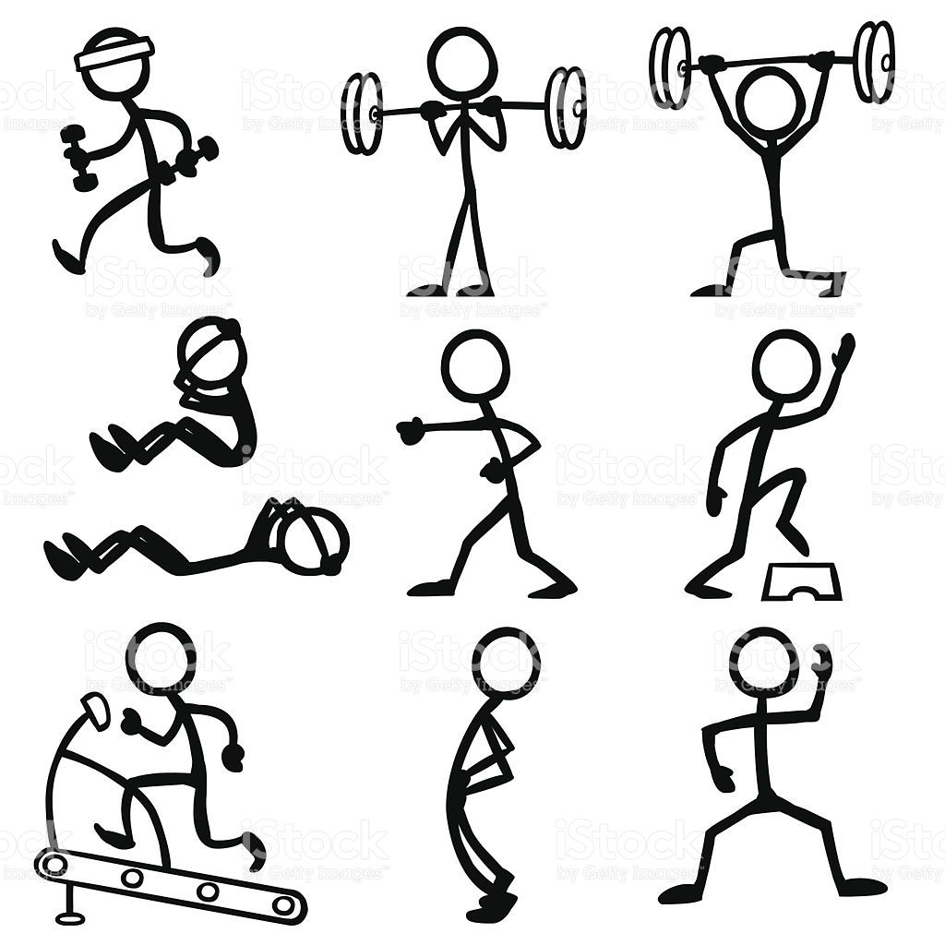
Group AMRAP Challenge
Workout Requirements:
Number of Group Members: 3 or 4
Equipment: Select 1 from the following – Medicine Ball, Sandbell, Resistance Bands
Number of Exercises: 4 (may include one body weight exercise).
Exercises: Must include at least one exercise each for upper body, core, and lower body.
Number of Reps: Group decision.
Workout Directions:
The group will complete the workout together.
We will complete this workout 3 times this week.
Your group must increase one aspect of your workout each time we complete the workout.

Slide 8
Student Designed Workout Group Project
We have been working on using various types of resistance training equipment during this school year. With this project, you will have a chance to demonstrate your expertise in terms of how to create a workout that works the whole body and utilizes appropriate and safe techniques. Below are the basics for completing this project with your group:
ILO: The student will create a workout using self-selected piece of equipment and exercises with a group of classmates using correct technique.
Success Criteria: I can work successfully with other students to design a quality workout using correct techniques.
Project Requirements:
Group must work together to create, perform, and present workout.
Includes a detailed plan with exercise list and workout intensity.
Must use either medicine balls or sandbells.
Should include at least 6 exercises that demonstrate correct techniques (at least 3 sets of 10 repetitions).
Performed and presented together as a group.
Workout is recorded and submitted using Flipgrid by the assigned due date.

Slide 9
Person Trainer Challenge Project
We have been working various types of workouts that include both body weight exercise and resistance training. In this project, you will be working with a group to create a complete workout including a warmup, workout including both body weight and weight training, and a cool down. With this project, you will have a chance to demonstrate your expertise in terms of how to create a workout that works the whole body and utilizes appropriate and safe techniques. Below are the basics for completing this project with your group:
ILO: The student will create a complete workout focused on total body fitness with a group of classmates using correct technique.
Success Criteria: I can work successfully with other students to design a quality workout using correct techniques.
Requirements:
Group must work together to create, perform, and present workout.
Includes a detailed plan with exercise list and workout intensity.
Must include a plan for warming up and cooling down.
Must use exercises from each exercise category including use of weighted bar.
Performed and presented together as a group.
Workout is recorded and submitted using Flipgrid by the assigned due date.

Slide 10
Sample Exit Tickets

Slide 11
What is one thing you learned about working with others today?

Slide 12
Fitness Spelling Challenge Exit Ticket
What was your word for today’s workout?
What was the most challenging exercise today? Why?

Slide 13
In one or two sentences, tell me one benefit to resistance training.

Slide 14
Tell me which component of fitness you worked on using the resistance bands.

Slide 15
Name one thing you did well today.

Slide 16
In one to two sentences, describe how to best make a good workout.

