Slide 1
You get a grade! You get a grade! EVERYONE GETS A GRADE!
Lei Dunn
LDunn@Schoolhealth.com
@leidunn_vb
Slide Deck
https://bit.ly/YouGetAGrade

Slide 2
Agenda
1. What is a grade and what is a rubric?
2. What options are available in the WELNET ® Rubrics Module?
3. Where do I fit formative assessment into my daily class time?

Slide 3
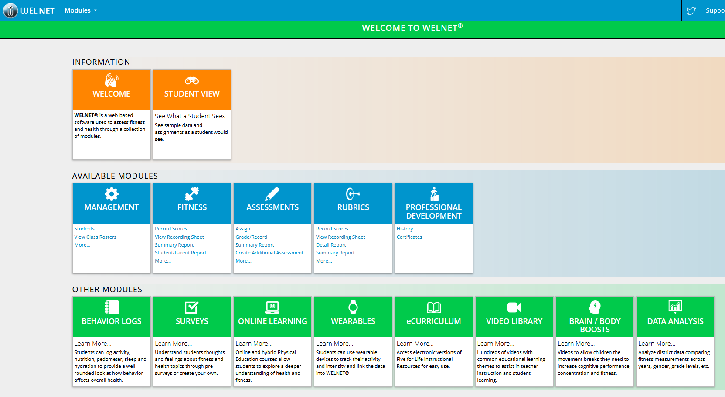
About WELNET®
WELNET® is a web-based software program used to assess health & fitness, as well as motor skills, through a collection of modules.
Elevates your current program…
Exceeds the minimum state requirements, goals & objectives…
Engages students and stakeholders…
Notes:
Lei

Slide 4
What is a grade?
The process of summarizing a student’s achievement represented in a numerical or ordinal scale.
Notes:
Jamie

Slide 5
What is a rubric?
A rubric is a type of scoring guide that assesses and articulates specific components and expectations for an assignment.
Cornell University Center for Teaching Inovation - https://teaching.cornell.edu/teaching-resources/assessment-evaluation/using-rubrics#:~:text=A%20rubric%20is%20a%20type,projects%2C%20portfolios%2C%20and%20presentations.
Notes:
Jamie

Slide 6
What is a rubric?
Three Main Types of Rubrics:
Analytic
Descriptive criteria for each level of performance
Holistic
Single scale with all criteria grouped for each level of performance
Checklist
Only two performance levels for each performance skill
DePaul University Teaching Commons - https://resources.depaul.edu/teaching-commons/teaching-guides/feedback-grading/rubrics/Pages/types-of-rubrics.aspx#:~:text=A%20holistic%20rubric%20consists%20of,judgment%20of%20the%20student%20work.
Notes:
Jamie

Slide 7
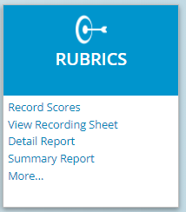
Rubrics Module
Rubrics Module (aka Motor Skills Module)
3 different ways to quickly score: Checklist, Holistic and Analytic
Includes pre-loaded definitions, critical elements and descriptors for over 80+ motor skills
District can map skills so teachers can see what they are supposed to assess
Summary reports provide valuable info about progress students are making on mastering motor skills
Notes:
Lei

Slide 8
Let’s see these 3 types with the same skill
Rope Jumping - two foot, single rope
Analytic
Descriptive criteria for each level of performance
Holistic
Single scale with all criteria grouped for each level of performance
Checklist
Only two performance levels for each performance skill
Notes:
Jamie

Slide 9
Be comfortable with online and offline recording.
Offline recording requires double data entry, but allows for portability and speed in grading.
Online recording may have less errors in data entry, but also may tie you to a particular location.
Notes:
Jamie

Slide 10
Options for fast formative assessment
Instant activity/entrance ticket
https://drive.google.com/file/d/1pp2uYuGonqktFnUcEYRsbYJ9Kp84wbRx/view?usp=drive_link
Stations
https://drive.google.com/file/d/1NXe8S_kw25KQPNVZhoXvaS3OVREMnj61/view?usp=drive_link
Relays
https://drive.google.com/file/d/1Q1y6HTwizwefYogKarPrJZo5BCOUlzew/view?usp=drive_link
Four corners/Around the world

Slide 11
Remember
A grade is not a measurement of the child, but a measurement of their performance.
Formatively assessing your students using rubrics allows you to focus in on areas they may need improvement in learning and understanding and areas you may need improvement in teaching and demonstrating.
Use your time, grades and lessons wisely.

Slide 12
You get a grade! You get a grade! EVERYONE GETS A GRADE!
Lei Dunn
LDunn@Schoolhealth.com
@leidunn_vb
Slide Deck
https://bit.ly/YouGetAGrade

