Slide 1
Michio Ihara

Slide 2
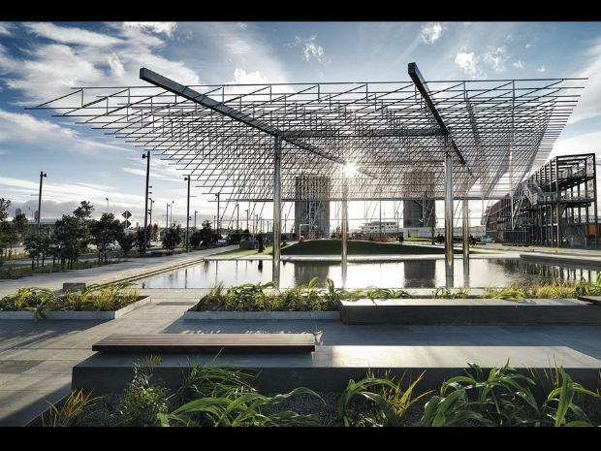
Group discussion

Slide 3
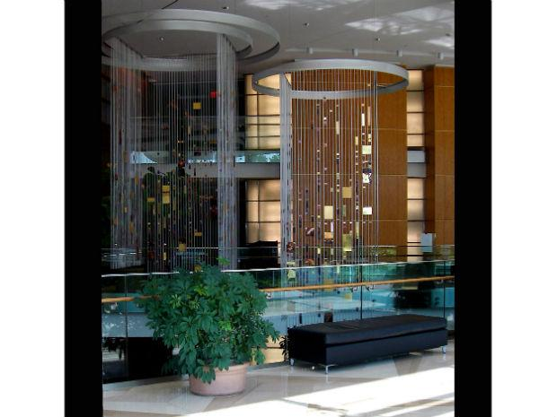
Group discussion

Slide 4
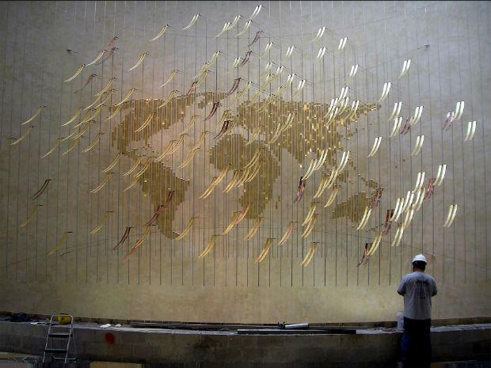
Group discussion

Slide 5
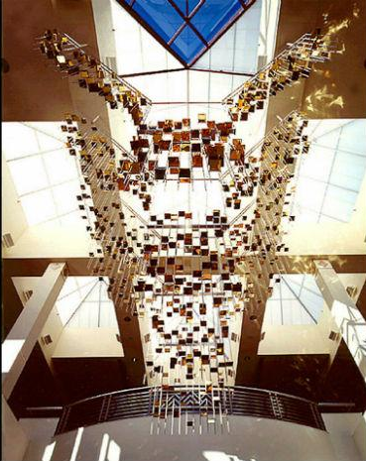
Group discussion

Slide 6
Find a partner

Slide 7
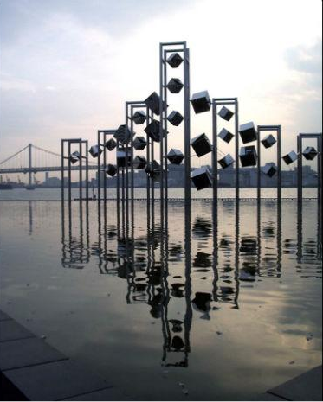
Image for partner work

