Slide 1
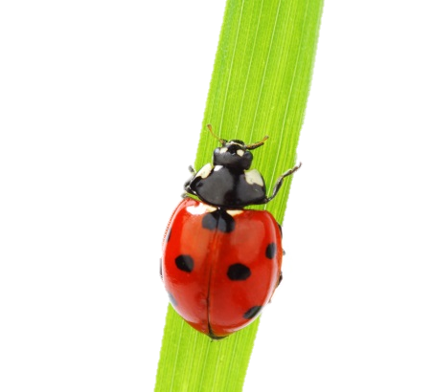
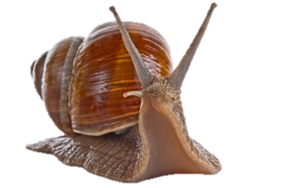
Department of Biology, Spring 2019 Biology Elective Offerings
Course | Title/Topic | Instructor | Animal Science | Ecology/ Evolution | Environmental Science | Genetics / Cell/ Molec. / Dev./Neuro-Biology | Human Related Biology | Micro-biology | Plant Science | Fulfills Organismal Diversity | Fulfills Upper Division Lab
245 | General Microbiology | Vasudevan |  |  |  |  |  | X
290 | Human Anatomy* | Multiple |  |  |  |  | X
304 | Cell & Molecular Biology | Daniel |  |  |  | X
309 | Marine & Freshwater Invertebrates | Wyngaard | X | X |  |  |  |  |  | X
320 | Comparative Anatomy of Vertebrates | Rose | X | X |  |  |  |  |  | X | X
343 | Immunology | Lantz |  |  |  | X | X | X
343L | Immunology Lab | Lantz |  |  |  | X | X | X |  |  | X
346 | Bacterial Discovery | Herrick |  | X | X | X | X | X |  |  | X
354 | Global Climate Change & Life | Cocking |  | X | X |  | X |  |  |  | X
370 | Animal Physiology | Parker |  |  |  |  | X |  |  |  | X
375 | Sensation & Perception | Andre | X |  |  | X | X
385 | Biopsychology | Shoup-Knox |  |  |  | X | X
386 | Field Biology | McMullen |  | X |  |  |  |  | X | X | X
387 | Environmental Microbiology | Steffen |  | X | X |  | X | X
387L | Environmental Microbiology Lab | Steffen |  | X | X |  | X | X |  |  | X
395 | Comparative Animal Behavior | Baker | X |  |  | X
400 | Geology & Ecology of the Bahamas | Wurch |  | X | X |  |  |  |  |  | X
404 | Evolutionary Analysis | Cooper |  | X | X
405 | Vertebrate Paleontology | Fichter | X | X
410 | Advanced Human Anatomy | Multiple |  |  |  |  | X
426 | Aging and Neurodegeneration | Walker |  |  |  | X | X
427 | Aquatics Microbiology Lab | Wurch |  | X | X |  |  | X |  |  | X
427 | Herpetology | McLeod | X | X |  |  |  |  |  | X | X
427 | Tropical Ecology & Restoration | Griscom |  | X | X |  | X |  |  |  | X
427 | Biological Applications of UAVs | Ludwig |  | X |  |  |  |  |  |  | X
446 | Experimental Neurobiology | Cleland | X |  |  | X | X |  |  |  | X
452 | Population Ecology | Ludwig |  | X | X
454 | Introduction to Biometrics | Wyngaard
457 | Biological Applications of GIS | Wiggins |  | X | X |  |  |  |  |  | X
460 | Plant Cell & Tissue Culture | Renfroe | X | X | X | X | X |  | X |  | X
468 | Endocrinology | Velayudhan | X |  |  | X | X
482 | Human Histology | Gabriele | X |  |  | X | X |  |  |  | X
491H | Scientific Writing, Presentation, & Critical Thinking | Rose°
*Restricted to Appropriate Pre-Professional Minors Until Open Enrollment
°By Permission for Non-honors Students

