Slide 1
SCOM Basic Course
Final Video Review
Chapters: 4,5,6

Slide 2
Instructions:
Take out a piece of paper and a writing utensil
Press “Slide Show” to watch it as a presentation
On each slide, click on the videos to play it.
After every video, write down your answers
When you are done, click “exit”
Check your answers in the “notes” section. Additionally, the rational is also stated in the “notes” section.
Good Luck!

Slide 3
Chapter 4: Language

Slide 4
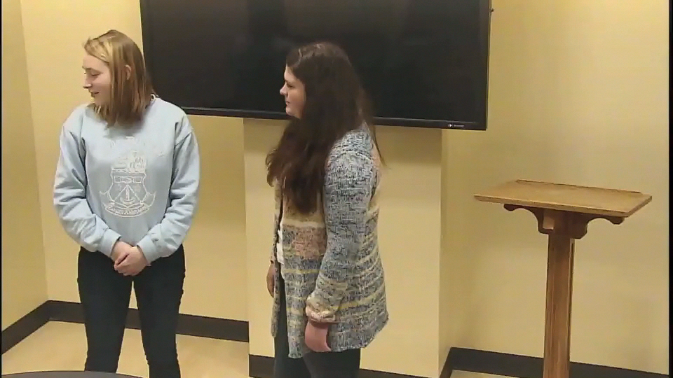
This interaction is between two communications students after a presentation. Is this a correct use of Jargon?
  A. Yes, it was correct.
  B. No, it was not correct.
  C. It was not ideal, but its ok.
  D. None of the above
Notes:
Answer: a. Yes, it was correct
Why: Since both of these students are communications majors, they both understand the jargon associated with communications studies. The second student even showed their knowledge by asking a follow up question.

Slide 5
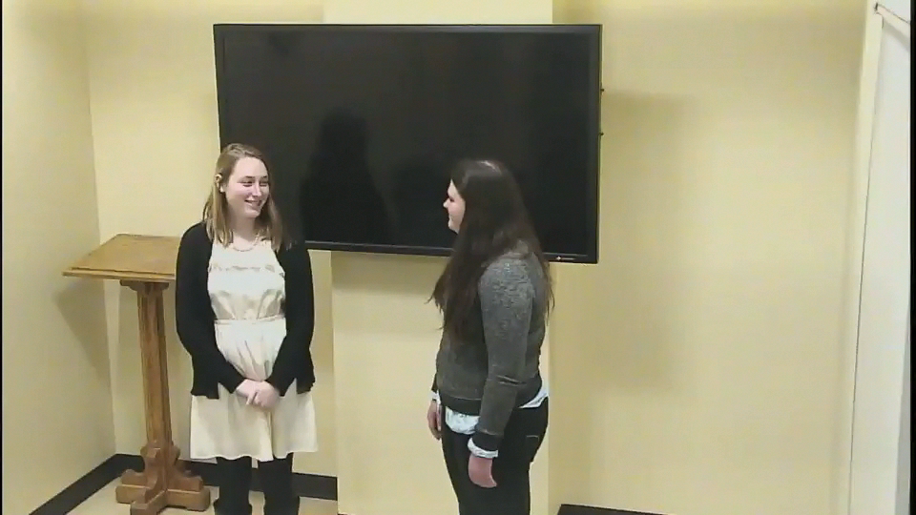
What communication term is displayed in the video?
a. Connotative meaning
b. Inference
c. Denotative meaning
d. Fact
Notes:
Answer: b. Inference
Why: The second speaker assumes that it will be warm based on it being sunny. However, it is not proven that it is warm, it is simply assumed by speaker 2.

Slide 6
Chapter 5: Nonverbal Communication

Slide 7
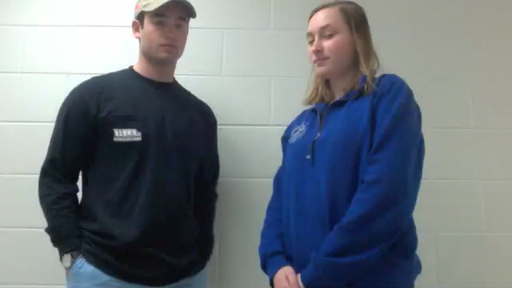
What function of verbal communication is being displayed in this clip?
a. Substitution
b. Repetition
c. Contradiction
d. Accentuation
Notes:
Answer: c. Contradiction
Why: the speaker is sending mixed messages by telling the other person exciting news but not looking happy about it. It is not substitution because there is no substituting nonverbal messages for verbal messages. It is not repetition because there is not repeating nonverbal cues. It is not accentuation because there is not emphasis on what the speaker is saying.

Slide 8
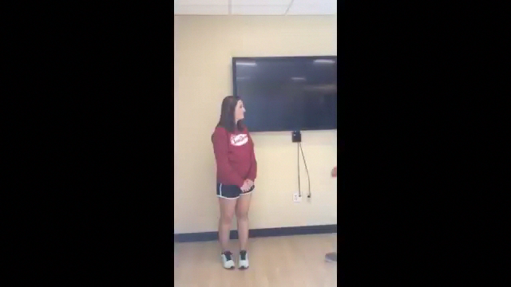
What major type of nonverbal communication is being violated in this clip?
a. Proxemics
b. Kinesics
c. Territoriality
d. Haptics
Notes:
Answer: a. Proxemics
Why: the distance between the two individuals is much too close for normal interaction and has an influence on the conversation. Kinesics is not correct because it just focuses on facial gestures. Territoriality is not correct because it focuses on defending a fixed, geographic area, an exclusive domain. Haptics is not correct because it is the study of touch.

Slide 9
Chapter 6: Listening to Others

Slide 10
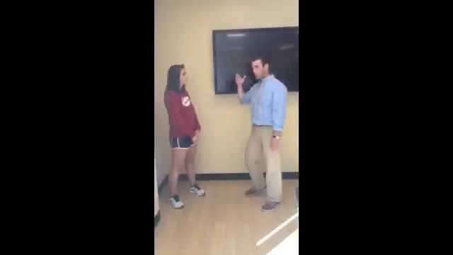
What type of listening is being displayed by person 2?
a. Informational
b. Critical
c. Empathetic
d. None of the above
Notes:
Answer: Empathetic
Why: the second speaker is trying to take the perspective of the first person and how they are feeling. It is not Informational because there is no clear attempt to comprehend the message of speaker one. It is not Critical because there is no process of evaluation of claims

Slide 11
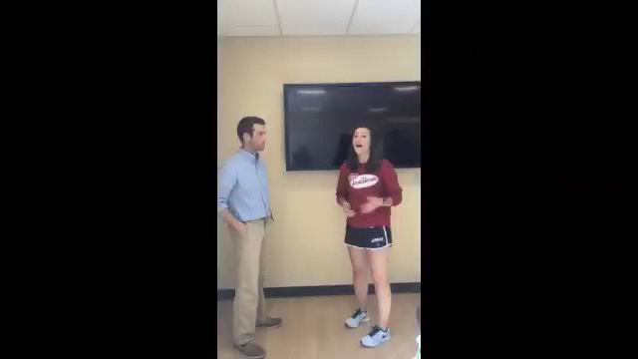
What type of conversational problem is the listener displaying in this clip?
a. Ambushing
b. Competitive Interrupting
c. Conversational Narcissism
d. Pseudo-Listening
Notes:
Answer: b. Conversational Narcissism
Why: the speaker is attempting to turn the conversation to themselves without showing sustained interest in the first speaker’s conversation. It is not ambushing because there is no interest in strengths and weaknesses. It is not competitive interrupting because there is no interruption taking place. It is not pseudo-listening because the second person is not pretending to listen.

Slide 12
Good Job! You have completed the review.
Now, please check your answers by exiting out of the “slide show” and look at each slide’s “notes” section.
If you need more assistance, make an appointment with the communications center: http://www.jmu.edu/commcenter/appointments.shtml
Thank you!

