Slide 1
Connecting with Student Affairs
Dean of Students, Office of Disability Services, Counseling Center

Slide 2
Vice President for Student Affairs Updates
Tim Miller
Notes:
Thank you for having us here today and thank you for your leadership at JMU.
We have wanted to find the best way to connect with all of you and to all of your faculty about a range of important topics.
My hope is that today is a beginning of what will be many opportunities to connect with you all to build relationships, share resources, and work together.
The three teams you are going to hear from are great partners and will provide significant support to you and our students
Thank you again for this time with you and I look forward to you meeting these incredible members of our team in Student Affairs

Slide 3
Dean of Students
Gloria Mast & Dom Rodriguez

Slide 4
What does the Dean of Students do?
1. General Support
Direct students & families to appropriate resources
Send "Student Absence Communication" for extended absences – visit our website for more info
Support faculty and staff through consulting
Discuss withdrawals from the university with students & families
2. Madison Cares
Referral program/early intervention for students in distress
Anyone can refer a student that they are concerned about
Our staff will provide outreach, support, and resources
Most referrals come from faculty about students they are concerned about in their classes
Currently seeing an increase in complex student concerns
Fall 2023 = 426 referrals
Fall 2024 = 474 referrals
3. Learning Success Strategies (LSS)
A service for all students to develop their time management, studying, test taking, note taking and reading comprehension skills
1:1 appointments with a Peer Learning Assistant
Most popular appointment = personalized planners
4. Rebound Program
Aims to normalize setbacks and obstacles through storytelling and mentorship
Refer students to Rebound if they are experiencing a set back and would be interested in meeting with a staff mentor
Visit our website to watch videos and listen to podcasts of JMU students, staff, alumni telling their stories

Slide 5
MadisonCares
Helping students experiencing a variety of challenges while at JMU.
Connect students with appropriate resources and provide advocacy during times of need.
Provide consultation to faculty, staff, students, family members, etc. on how to navigate concerning situations.
Be a support for students in distress before situation could escalate.
NOT first responders and should not be used for emergency situations. Please call JMU PD if someone need immediate assistance.
Questions about Madison Cares? Email us at madisoncares@jmu.edu
Notes:
Dom

Slide 6
Referring a student to Madison Cares
Talk to the Student (preferably face-to-face)
Share Your Concerns privately and objectively
Receive their feedback and gather information
Tell them what Madison Cares is
Submit referral to Madison Cares on our website
Notes:
Dom

Slide 7
How We Respond
Assign Madison Cares team member to the referral
Reach out to referrer and student
Meet with the student
Connect student with appropriate resources
Optional: follow up meetings, check ins via email/phone
Notify referrer when referral is closed
Notes:
Dom
We've mentioned a few different teams and assigning a "level of risk" to a situation. We thought showing you a visual of how our system currently functions would help explain these further.
If you start on the left hand side of the screen you will notice that for our process to begin someone needs to notice a concern. If that concern is imminent (threat of violence to self or others, significant disruption), that is not something our office responds to. 911/Campus Police are to be called and they are to respond. A Madison Cares referral can still be submitted but it should be after emergency services have intervened. Dean of Students are not first responders and this distinction has now clearly been made. The Threat Assessment Team is chaired but Threat Assessment Analyst housed out of JMU Police which helps with this distinction. There was an expectation in the past that DOS was first responders and available to respond to emergent situations. This is no longer the expectation.
All other concerns will follow the other path on the screen. Someone notices a concern, they submit a Madison Cares referral on our website, Dean of Students staff review the referral and then assign it to the proper staff member/team. The way we make these assignments is by using a Low, Moderate, or High distinction.
These are defined as:
High – individual poses an articulable and significant threat of violence to others, imminent threat to self, and/or a significant disruption to the campus community – goes to Police/TAT
Moderate – individual not known to pose a current threat of serious violence or harm to self or others though risk cannot be rules out – goes to Associate Deans/SAT
Low – individual does not appear to pose threat of harm to self/others nor significant disruption but may need resources – goes to Assistant Dean/MC

Slide 8
Thank you!
Dean of Students
Student Success Center, Suite 3010
Phone: 540-568-6468
Dom Rodriguez, Assistant Dean of Students | rodrigdv@jmu.edu
Gloria Mast, Associate Dean of Students | mastgm@jmu.edu
Notes:
Dom
The reason we are here with you today is to talk about how we have managed and maintained the growth of Madison Cares, so let's get into that.
This past academic year we saw our number of referrals more than double. With the growth in number of referrals and complexity of issues Madison Cares was receiving, our team needed to make changes to our process in order to not only remain efficient and provide the best service possible to our community, but to also maintain an amount of work that was sustainable for the staff we have. We knew the answer was not going to be "let's hire more staff".
The main question we usually receive when we show people this chart is what changed between the 2021-2022 school year and the 2022-2023 school year. We think we can attribute this increase to 2 different things.
First, our staff was able to start intentionally marketing Madison Cares to specific populations. For example, Madison Cares was highly emphasized to all families who attended summer 2022 orientation with their incoming student, and HDs were trained on how to properly use Madison Cares during their August 2022 training. Second, 2022 was year 4 of the existence of Madison Cares, this means that with the exception of the incoming first year class/ new transfers, all JMU students have been with us since Madison Cares started. We reached a point in the existence of this program that it was becoming part of the campus culture.
I will also mention that in speaking with other universities who manage very similar programs, they have seen a similar change in their referral numbers over the past year and are also in the process of updating their procedures as well.

Slide 9
Office of Disability Services
Brittany Dioszeghy

Slide 10
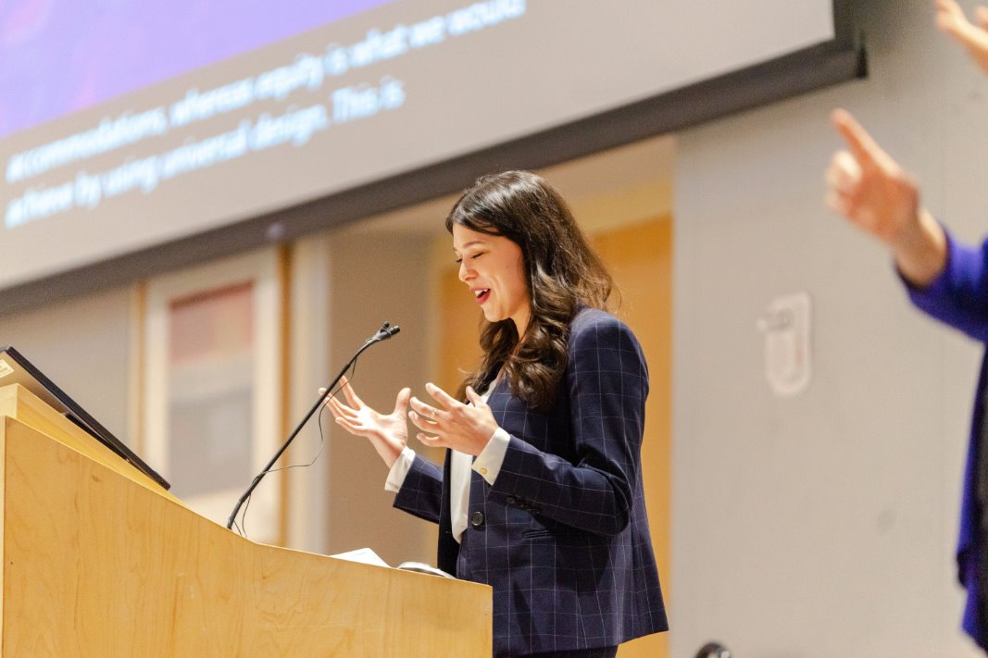
Office of Disability Services Mission
ODS Collaborates with the JMU community, providing programs and support services that promote and advocate for accessible learning environments that value disability and create a sense of belonging.

Slide 11
Laws
Policies
Americans with Disabilities Act, as amended
Section 504 of the Rehabilitation Act of 1973, as amended
Fair Housing Act
JMU Policy 1331. Disabilities & Reasonable Accommodations
JMU Policy 1324. Disability Discrimination & Complaint Procedure
JMU Policy 1211. Information Technology Accessibility

Slide 12
JMU Policy 1331. ODS Responsibility
7.4 ODS is responsible for processing and assessing requests for disability accommodations from students, and for providing access plans* and advice to faculty members and administrators concerning reasonable accommodations for students.
*also referred to as "Accommodation Letters"

Slide 13
JMU Policy 1331. Student Responsibility
7.2 A student is responsible for providing adequate notification to ODS of the need for accommodation for a disability. The student is also responsible for providing appropriate documentation of the disability and for cooperating with the university in attempting to reach an agreement on a reasonable accommodation.

Slide 14
JMU Policy 1331. Faculty Responsibility
7.9 Faculty members are responsible for providing reasonable accommodations regarding classwork, assignments, and attendance to students.

Slide 15
ODS Legal Mandate
To accurately identify:
Whether a student has a disability, according to the 504/ADA definition*
Disability-related reasonable accommodations
*Disability: A documented physical or mental impairment that substantially limits one or more major life activities, a record of such an impairment, or being regarded as having such an impairment

Slide 16
JMU Accommodation Application Process
Step 1: Student submits the Disability Services application and documentation through the Accommodate system on the ODS website
JMU ODS Documentation Guidelines
Documentation Resources
ODS Screening & Referral
JMU Interprofessional Services for Learning Assessment
VA Department of Aging and Rehabilitative Services
Step 2: A Disability Services Practitioner conducts an individualized review
All decisions regarding accommodations are based on a legally-grounded interactive process that includes:
verifying the presence of a disability,
identifying barriers that are the result of this disability, and then
identifying reasonable accommodations that mitigate the impact of these barriers
Step 3: All students who are approved for an accommodation are required to complete a registration meeting with a Disability Services Practitioner

Slide 17
Accommodation Implementation Process
Each semester:
Registered students can choose which approved accommodations to use in each of their classes in the Accommodate system
ODS sends official Accommodation Letters to faculty
Faculty provide the accommodations listed on the Accommodation Letter, unless a legal exception applies

Slide 18
Legal Exceptions to Implementing Accommodations
Legally requires a review process with relevant campus experts
Undue burden
Administrative/financial
Fundamental alteration
Preserves the essential nature/objectives of a class or program

Slide 19
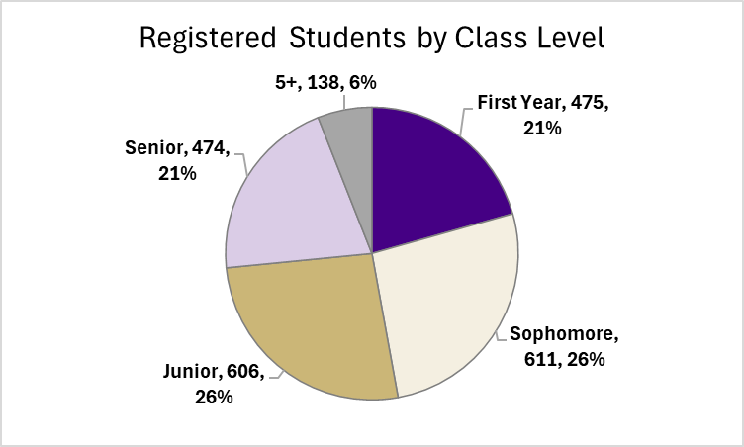
Students Registered with ODS
2,304
Registered Students
(October 2024)
10% of JMU Student Population

Slide 20
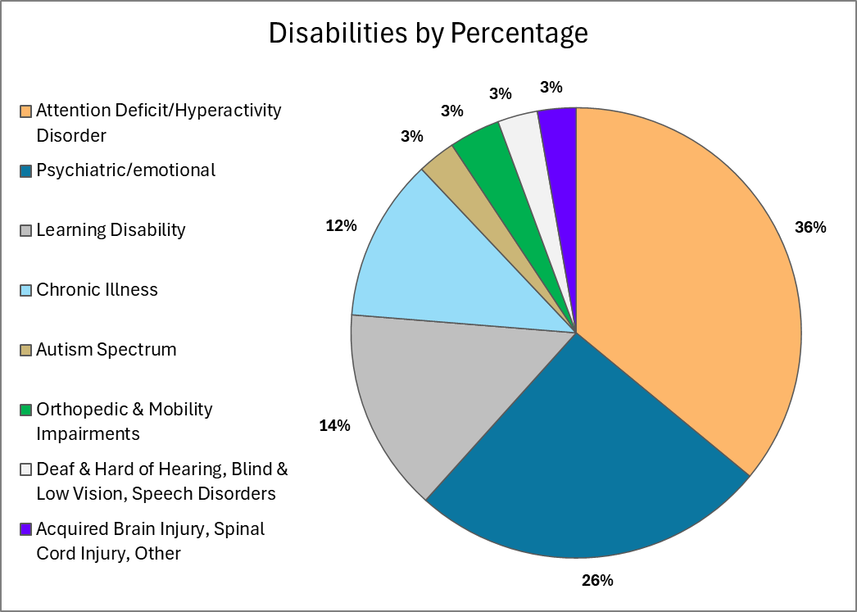
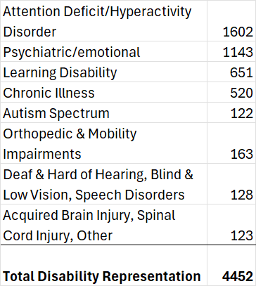
Disability Representation
Disability Category Frequency

Slide 21
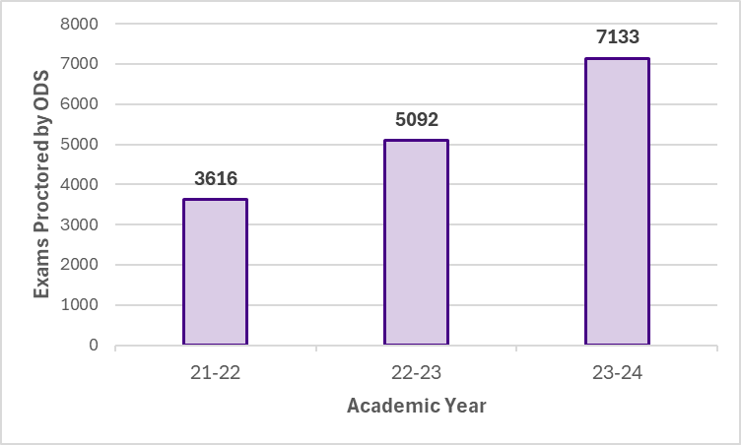
Annual Exams Proctored by ODS

Slide 22
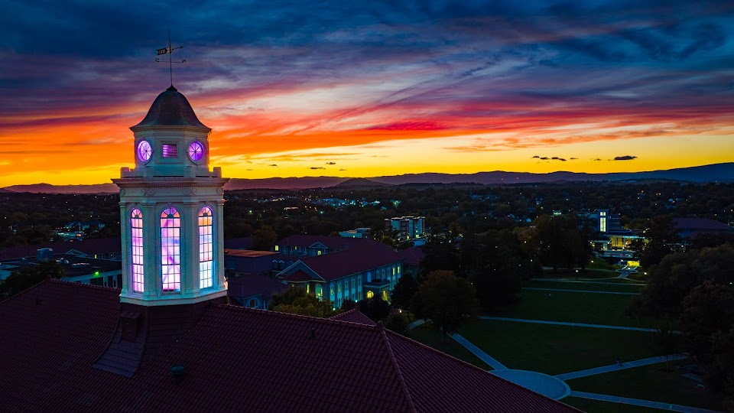
New ODS Evening Exam Proctoring Hours
This semester, ODS has expanded to providing an evening block of proctoring hours to support faculty and students with evening classes.

Slide 23
Existing and Developing Partnerships for Exam Accommodations
College of Business
School of Communications
Assessment and Testing Center
Others in process

Slide 24
Partnership Opportunities
Accessible Design Coordinator positions within colleges (UVA)
Support faculty with providing testing accommodations and designing courses for accessibility
Institution-wide testing resources for faculty (accommodated and non-accommodated exams)
Space
Proctors
Paper and online format capacity
Test/Exam Design
Support faculty in designing sustainable assessment methods that reduce the volume of timed tests/quizzes and accurately assess learning outcomes

Slide 25
Thank you for your partnership

Slide 26
Counseling Center
David Onestak
onestadm@jmu.edu

Slide 27
Counseling Center (CC) Overview
The CC provides free, confidential counseling and psychiatric services to JMU students, and we consult with others, including JMU faculty and staff members, who are concerned about a student.
Anyone who follows media reports has seen headlines suggesting that a mental health crisis exists at U.S. colleges and universities, and that it is worsening.
The CC is experiencing extremely high levels of acuity:
195 crisis intakes
43 post-intake crisis appointments
24 referrals for psychiatric hospitalization

Slide 28
CC Overview Cont'd
The CC provides students with individual counseling to assist them with a variety of personal and interpersonal concerns that are impacting their quality of life and their academic performance.
Last year, 74% of students reported that our services helped them to both improve their academic performance and to remain in school. The CC is one of JMU’s most important academic support resources.
The CC operates under a short-term treatment model under which the student and the counselor collaboratively identify and address the student’s primary concerns within a limited number of sessions, normally 4 to 6 sessions.

Slide 29
CC Overview Cont'd
The CC has a very active group counseling program, and each semester, students have the opportunity to participate in small group experiences (6 – 8 students) on issues related to their needs.
The CC has two psychiatric providers who prescribe medications that may be helpful to students dealing with psychological issues.
The CC also staffs a well-developed emergency services model, with 24/7 services in place to help students experiencing a serious crisis such as threat of harm to themselves or to others or a recent sexual assault.
After hours, faculty should call the CC at (540) 568-6552 and press “1”

Slide 30
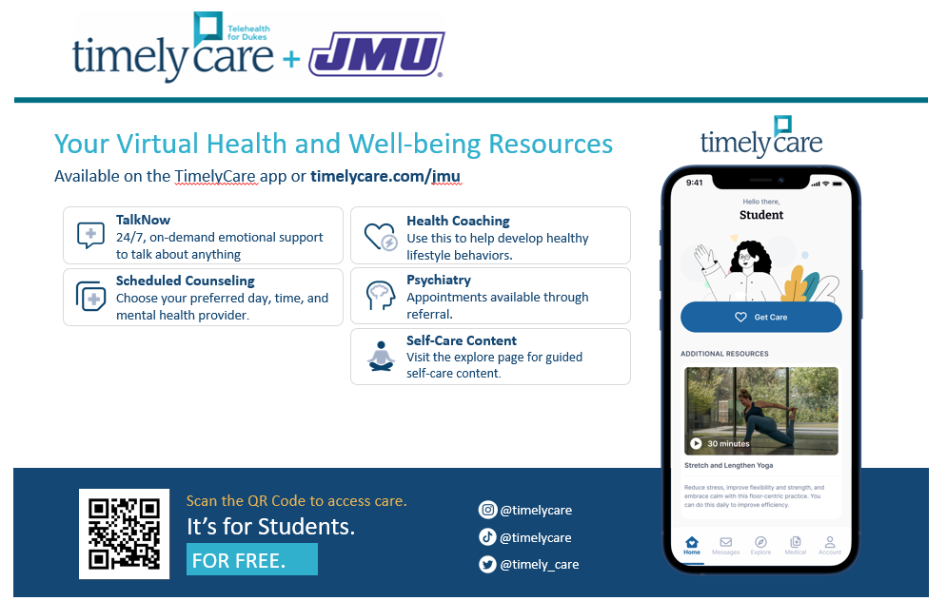

Slide 31
Questions?

