Slide 1
How to Operate your HVAC system
Lake Area

Slide 2
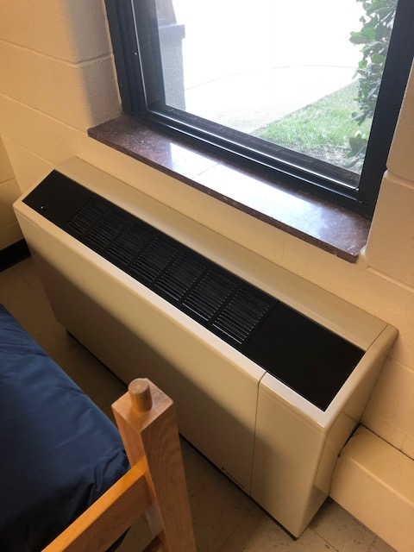
Avoid Restriction of Air Flow
NOT THIS!
THIS!

Slide 3
Setting your HVAC System

Slide 4
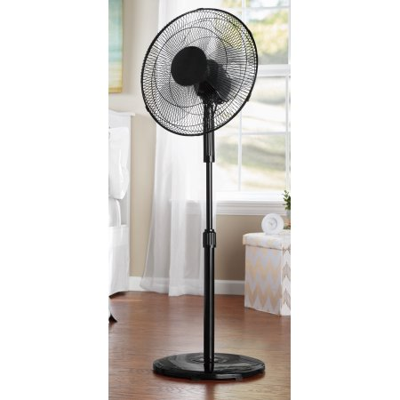
We suggest you use…. Village Common areas have window units, but bedrooms currently only have a heating system
Box Fan
Oscillating Fan

Slide 5
Temperature Regulations
Above 60 degrees
Below 60 degrees

Slide 6
How to report a non-functioning unit…
To fill out a maintenance request to fix the unit visit: http://www.jmu.edu/orl/maintenance/
An air conditioning unit that is not functioning properly is not considered an emergency. It may take 3 to 5 business days for the unit to be serviced.
Only non-functioning heating units are an emergency.

Slide 7
THANK YOU!
We look forward to seeing you on campus!
GO DUKES!

